Slide 1
Parallel Computing Platforms
Dr. Nausheen Shoaib

Slide 2
Scope of Parallelism
Conventional architectures coarsely comprise of a processor, memory system, and the datapath.
Each of these components present significant performance bottlenecks.
Parallelism addresses each of these components in significant ways.
Different applications utilize different aspects of parallelism - e.g., data itensive applications utilize high aggregate throughput, server applications utilize high aggregate network bandwidth, and scientific applications typically utilize high processing and memory system performance.
It is important to understand each of these performance bottlenecks.

Slide 3
Implicit Parallelism: Trends in Microprocessor Architectures
Microprocessor clock speeds have posted impressive gains over the past two decades (two to three orders of magnitude).
Higher levels of device integration have made available a large number of transistors.
The question of how best to utilize these resources is an important one.
Current processors use these resources in multiple functional units and execute multiple instructions in the same cycle.
The precise manner in which these instructions are selected and executed provides impressive diversity in architectures.

Slide 4
Pipelining and Superscalar Execution
Pipelining overlaps various stages of instruction execution to achieve performance.
At a high level of abstraction, an instruction can be executed while the next one is being decoded and the next one is being fetched.
This is akin to an assembly line for manufacture of cars.

Slide 5
Pipelining and Superscalar Execution
Pipelining, however, has several limitations.
The speed of a pipeline is eventually limited by the slowest stage.
For this reason, conventional processors rely on very deep pipelines (20 stage pipelines in state-of-the-art Pentium processors).
However, in typical program traces, every 5-6th instruction is a conditional jump! This requires very accurate branch prediction.
The penalty of a misprediction grows with the depth of the pipeline, since a larger number of instructions will have to be flushed.

Slide 6
Pipelining and Superscalar Execution
One simple way of alleviating these bottlenecks is to use multiple pipelines.
The question then becomes one of selecting these instructions.

Slide 7
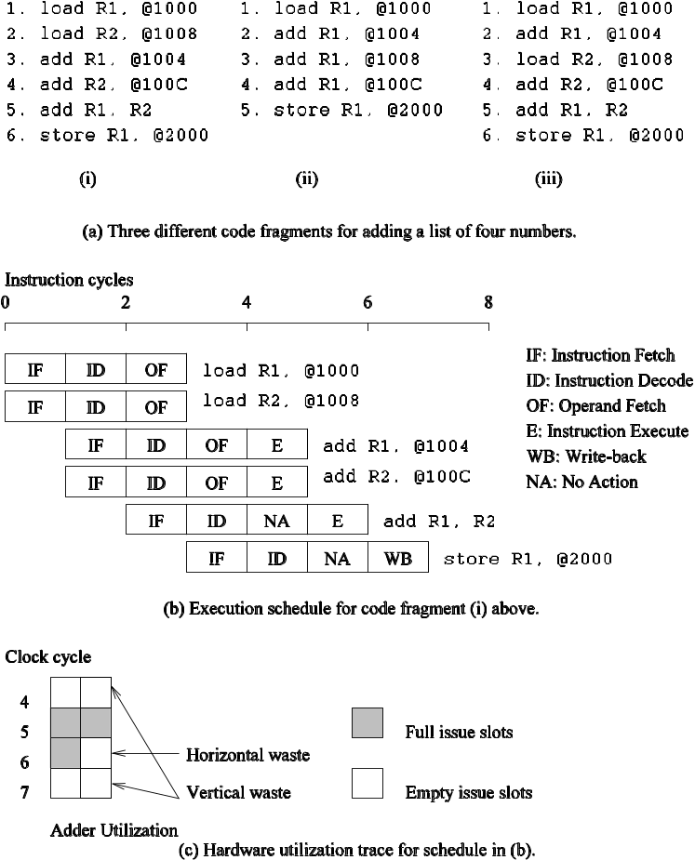
Superscalar Execution: An Example
Example of a two-way superscalar execution of instructions.

Slide 8
Superscalar Execution: An Example
In the above example, there is some wastage of resources due to data dependencies.
The example also illustrates that different instruction mixes with identical semantics can take significantly different execution time.

Slide 9
Superscalar Execution
Scheduling of instructions is determined by a number of factors:
  True Data Dependency: The result of one operation is an input to the next.
  Resource Dependency: Two operations require the same resource.
  Branch Dependency: Scheduling instructions across conditional branch statements cannot be done deterministically a-priori.
  The scheduler, a piece of hardware looks at a large number of instructions in an instruction queue and selects appropriate number of instructions to execute concurrently based on these factors.
  The complexity of this hardware is an important constraint on superscalar processors.

Slide 10
Superscalar Execution:
Issue Mechanisms
In the simpler model, instructions can be issued only in the order in which they are encountered. That is, if the second instruction cannot be issued because it has a data dependency with the first, only one instruction is issued in the cycle. This is called in-order issue.
In a more aggressive model, instructions can be issued out of order. In this case, if the second instruction has data dependencies with the first, but the third instruction does not, the first and third instructions can be co-scheduled. This is also called dynamic issue.
Performance of in-order issue is generally limited.

Slide 11
Superscalar Execution:
Efficiency Considerations
Not all functional units can be kept busy at all times.
If during a cycle, no functional units are utilized, this is referred to as vertical waste.
If during a cycle, only some of the functional units are utilized, this is referred to as horizontal waste.
Due to limited parallelism in typical instruction traces, dependencies, or the inability of the scheduler to extract parallelism, the performance of superscalar processors is eventually limited.
Conventional microprocessors typically support four-way superscalar execution.

Slide 12
Very Long Instruction Word (VLIW) Processors
The hardware cost and complexity of the superscalar scheduler is a major consideration in processor design.
To address this issues, VLIW processors rely on compile time analysis to identify and bundle together instructions that can be executed concurrently.
These instructions are packed and dispatched together, and thus the name very long instruction word.
This concept was used with some commercial success in the Multiflow Trace machine (circa 1984).
Variants of this concept are employed in the Intel IA64 processors.

Slide 13
Very Long Instruction Word (VLIW) Processors: Considerations
Issue hardware is simpler.
Compiler has a bigger context from which to select co-scheduled instructions.
Compilers, however, do not have runtime information such as cache misses. Scheduling is, therefore, inherently conservative.
Branch and memory prediction is more difficult.
VLIW performance is highly dependent on the compiler. A number of techniques such as loop unrolling, speculative execution, branch prediction are critical.
Typical VLIW processors are limited to 4-way to 8-way parallelism.

Slide 14
Limitations of
Memory System Performance
Memory system, and not processor speed, is often the bottleneck for many applications.
Memory system performance is largely captured by two parameters, latency and bandwidth.
Latency is the time from the issue of a memory request to the time the data is available at the processor.
Bandwidth is the rate at which data can be pumped to the processor by the memory system.

Slide 15
Memory System Performance: Bandwidth and Latency
It is very important to understand the difference between latency and bandwidth.
Consider the example of a fire-hose. If the water comes out of the hose two seconds after the hydrant is turned on, the latency of the system is two seconds.
Once the water starts flowing, if the hydrant delivers water at the rate of 5 gallons/second, the bandwidth of the system is 5 gallons/second.
If you want immediate response from the hydrant, it is important to reduce latency.
If you want to fight big fires, you want high bandwidth.

Slide 16
Memory Latency: An Example
Consider a processor operating at 1 GHz (1 ns clock) connected to a DRAM with a latency of 100 ns (no caches). Assume that the processor has two multiply-add units and is capable of executing four instructions in each cycle of 1 ns. The following observations follow:
  The peak processor rating is 4 GFLOPS.
  Since the memory latency is equal to 100 cycles and block size is one word, every time a memory request is made, the processor must wait 100 cycles before it can process the data.
Kilo 10³, Mega 10⁶, Giga 10⁹, Tera 10¹², Peta 10¹⁵, Exa 10¹⁸, Zetta 10²¹, Yotta 10²⁴,
Milli 10⁻³, Micro 10⁻⁶, Nano 10⁻⁹, Peco 10⁻¹², Femto 10⁻¹⁵,

Slide 17
Memory Latency: An Example
On the above architecture, consider the problem of computing a dot-product of two vectors.
  A dot-product computation performs one multiply-add on a single pair of vector elements, i.e., each floating point operation requires one data fetch.
  It follows that the peak speed of this computation is limited to one floating point operation every 100 ns, or a speed of 10 MFLOPS, a very small fraction of the peak processor rating!

Slide 18
On the above architecture, consider the problem of computing a dot-product of two vectors.
  A dot-product computation performs one multiply-add on a single pair of vector elements, i.e., each floating point operation requires one data fetch.
  It follows that the peak speed of this computation is limited to one floating point operation every 100 ns, or a speed of 10 MFLOPS, a very small fraction of the peak processor rating!
int dotProduct(int vect_A[], int vect_B[]) {
int product = 0;
// Loop for calculate dot product
for (int i = 0; i < n; i++)
product = product + vect_A[i] * vect_B[i];
return product;
}
LD R1, [R2] ; 100ns
LD R3, [R4] ; 100ns
MADD R5, R1, R2 ; 1ns
2/200ns= 10 MFLOPS

Slide 19
Improving Effective Memory
Latency Using Caches
Caches are small and fast memory elements between the processor and DRAM.
This memory acts as a low-latency high-bandwidth storage.
If a piece of data is repeatedly used, the effective latency of this memory system can be reduced by the cache.
The fraction of data references satisfied by the cache is called the cache hit ratio of the computation on the system.
Cache hit ratio achieved by a code on a memory system often determines its performance.
What is the average memory access time if cache hit is 85% for a 100nsec memory access time.

Slide 20
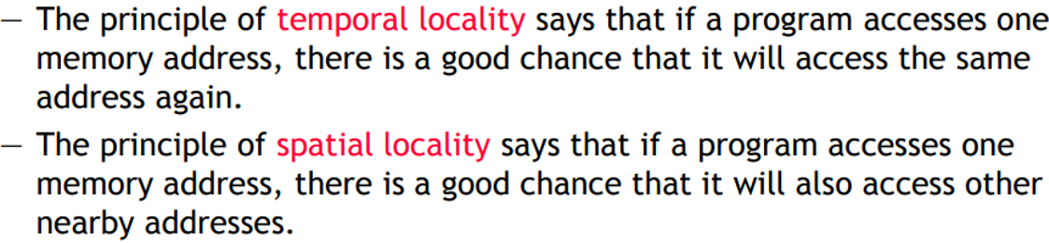
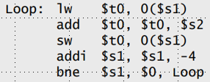



Slide 21
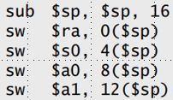



Slide 22
Impact of Caches: Example
Consider the architecture from the previous example. In this case, we introduce a cache of size 32 KB with a latency of 1 ns or one cycle. We use this setup to multiply two matrices A and B of dimensions 32 × 32.
  We have carefully chosen these numbers so that the cache is large enough to store matrices A and B, as well as the result matrix C.
for(i=0;i<r;i++) {
for(j=0;j<c;j++) {
for(k=0;k<c;k++) {
mul[i][j]+=a[i][k]*b[k][j];
}}}
O (N³)
Action items( Homework )
Draw processor, cache and memory
Draw Cache of size 32 K
How three matrices of size 32 x 32 fits into this cache?
How cache data is reused during these calculations?

Slide 23
Impact of Caches: Example (continued)
The following observations can be made about the problem:
  Fetching the two matrices (n x n = 32 x 32) into the cache corresponds to fetching 2K words, which takes approximately 200 µs. HOW?
  Multiplying two n × n matrices takes 2n³ operations. For our problem, this corresponds to 64K operations, which can be performed in 16K cycles (or 16 µs) at four instructions per cycle.
  The total time for the computation is therefore approximately the sum of time for load/store operations and the time for the computation itself, i.e., 200 + 16 µs.
  This corresponds to a peak computation rate of 64K/216 or 303 MFLOPS.
A thirty-fold improvement over the previous example. However, it is still less than 10% of the peak processor performance. By placing a small cache memory, we are able to improve processor utilization considerably.

Slide 24
Impact of Memory Bandwidth
Memory bandwidth is determined by the bandwidth of the memory bus as well as the memory units.
• Memory bandwidth can be improved by increasing the size of memory blocks.
The underlying system takes l time units (where l is the latency of the system) to deliver b units of data (where b is the block size).

Slide 25
Impact of Memory Bandwidth: Example
Consider the same setup as before, except in this case, the block size is 4 words instead of 1 word. We repeat the dot-product computation in this scenario:
  Assuming that the vectors are laid out linearly in memory, eight FLOPs (four multiply-adds) can be performed in 200 cycles.
  This is because a single memory access fetches four consecutive words in the vector.
  Therefore, two accesses can fetch four elements of each of the vectors. This corresponds to a FLOP every 25 ns, for a peak speed of 40 MFLOPS.

Slide 26
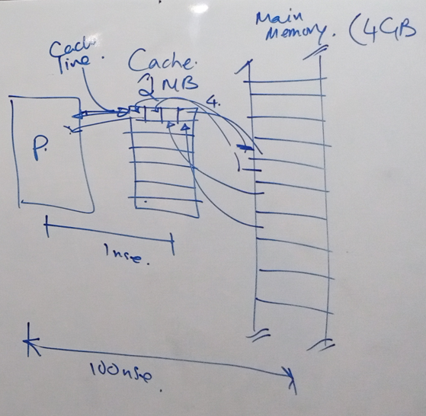
Cache: Pre-fetching data
CPU in fact stores not only demanded data into cache. It also loads neighbouring (following) data in cache because it’s very likely that these data will be requested soon. Operation of reading more data than requested is called prefetching. If such prefetched data is in fact requested in the nearest future, it can be loaded with cache hit latency instead of expensive main memory reference.
http://katecpp.github.io/cache-prefetching/

Slide 27
Impact of Memory Bandwidth
It is important to note that increasing block size does not change latency of the system.
Physically, the scenario illustrated here can be viewed as a wide data bus (4 words or 128 bits) connected to multiple memory banks.
In practice, such wide buses are expensive to construct.
In a more practical system, consecutive words are sent on the memory bus on subsequent bus cycles after the first word is retrieved.

Slide 28
Impact of Memory Bandwidth
The above examples clearly illustrate how increased bandwidth results in higher peak computation rates.
The data layouts were assumed to be such that consecutive data words in memory were used by successive instructions (spatial locality of reference).
If we take a data-layout centric view, computations must be reordered to enhance spatial locality of reference.

Slide 29
Impact of Memory Bandwidth: Example
Consider the following code fragment:
for (i = 0; i < 1000; i++)
column_sum[i] = 0.0;
for (j = 0; j < 1000; j++)
column_sum[i] += b[j][i];
The code fragment sums columns of the matrix b into a vector column_sum.

Slide 30
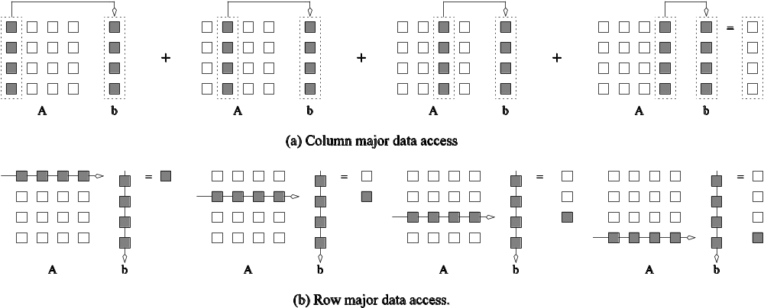
Impact of Memory Bandwidth: Example
The vector column_sum is small and easily fits into the cache
The matrix b is accessed in a column order.
The strided access results in very poor performance.
Multiplying a matrix with a vector: (a) multiplying column-by-column, keeping a running sum; (b) computing each element of the result as a dot product of a row of the matrix with the vector.

Slide 31
Impact of Memory Bandwidth: Example
We can fix the above code as follows:
for (i = 0; i < 1000; i++)
column_sum[i] = 0.0;
for (j = 0; j < 1000; j++)
for (i = 0; i < 1000; i++)
column_sum[i] += b[j][i];
In this case, the matrix is traversed in a row-order and performance can be expected to be significantly better.

Slide 32
Memory System Performance: Summary
The series of examples presented in this section illustrate the following concepts:
  Exploiting spatial and temporal locality in applications is critical for amortizing memory latency and increasing effective memory bandwidth.
  In Spatial Locality, nearby instructions to recently executed instruction are likely to be executed soon. In Temporal Locality, a recently executed instruction is likely to be executed again very soon. 2. It refers to the tendency of execution which involve a number of memory locations
  The ratio of the number of operations to number of memory accesses is a good indicator of anticipated tolerance to memory bandwidth.
  Memory layouts and organizing computation appropriately can make a significant impact on the spatial and temporal locality.

Slide 33
Alternate Approaches for
Hiding Memory Latency
Consider the problem of browsing the web on a very slow network connection. We deal with the problem in one of three possible ways:
  we anticipate which pages we are going to browse ahead of time and issue requests for them in advance;
  we open multiple browsers and access different pages in each browser, thus while we are waiting for one page to load, we could be reading others; or
  we access a whole bunch of pages in one go - amortizing the latency across various accesses.
The first approach is called prefetching, the second multithreading, and the third one corresponds to spatial locality in accessing memory words.

Slide 34
Multithreading for Latency Hiding
A thread is a single stream of control in the flow of a program.
We illustrate threads with a simple example:
for (i = 0; i < n; i++)
c[i] = dot_product(get_row(a, i), b);
Each dot-product is independent of the other, and therefore represents a concurrent unit of execution. We can safely rewrite the above code segment as:
for (i = 0; i < n; i++)
c[i] = create_thread(dot_product,get_row(a, i), b);

Slide 35
Multithreading for Latency Hiding: Example
In the code, the first instance of this function accesses a pair of vector elements and waits for them.
In the meantime, the second instance of this function can access two other vector elements in the next cycle, and so on.
After l units of time, where l is the latency of the memory system, the first function instance gets the requested data from memory and can perform the required computation.
In the next cycle, the data items for the next function instance arrive, and so on. In this way, in every clock cycle, we can perform a computation.

Slide 36
Multithreading for Latency Hiding
The execution schedule in the previous example is predicated upon two assumptions: the memory system is capable of servicing multiple outstanding requests, and the processor is capable of switching threads at every cycle.
It also requires the program to have an explicit specification of concurrency in the form of threads.
Machines such as the HEP and Tera rely on multithreaded processors that can switch the context of execution in every cycle. Consequently, they are able to hide latency effectively.

Slide 37
Prefetching for Latency Hiding
Misses on loads cause programs to stall.
Why not advance the loads so that by the time the data is actually needed, it is already there!
The only drawback is that you might need more space to store advanced loads.
However, if the advanced loads are overwritten, we are no worse than before!

Slide 38
Tradeoffs of Multithreading and Prefetching
Multithreading and prefetching are critically impacted by the memory bandwidth. Consider the following example:
  Consider a computation running on a machine with a 1 GHz clock, 4-word cache line, single cycle access to the cache, and 100 ns latency to DRAM. The computation has a cache hit ratio at 1 KB of 25% and at 32 KB of 90%. Consider two cases: first, a single threaded execution in which the entire cache is available to the serial context, and second, a multithreaded execution with 32 threads where each thread has a cache residency of 1 KB.
  If the computation makes one data request in every cycle of 1 ns, you may notice that the first scenario requires 400MB/s of memory bandwidth and the second, 3GB/s.

Slide 39
Tradeoffs of Multithreading and Prefetching
Bandwidth requirements of a multithreaded system may increase very significantly because of the smaller cache residency of each thread.
Multithreaded systems become bandwidth bound instead of latency bound.
Multithreading and prefetching only address the latency problem and may often exacerbate the bandwidth problem.
Multithreading and prefetching also require significantly more hardware resources in the form of storage.

Slide 40
Interconnection Networks for Parallel Computers
Interconnection networks carry data between processors and to memory.
Interconnects are made of switches and links (wires, fiber).
Interconnects are classified as static or dynamic.
Static networks consist of point-to-point communication links among processing nodes and are also referred to as direct networks.
Dynamic networks are built using switches and communication links. Dynamic networks are also referred to as indirect networks.

Slide 41
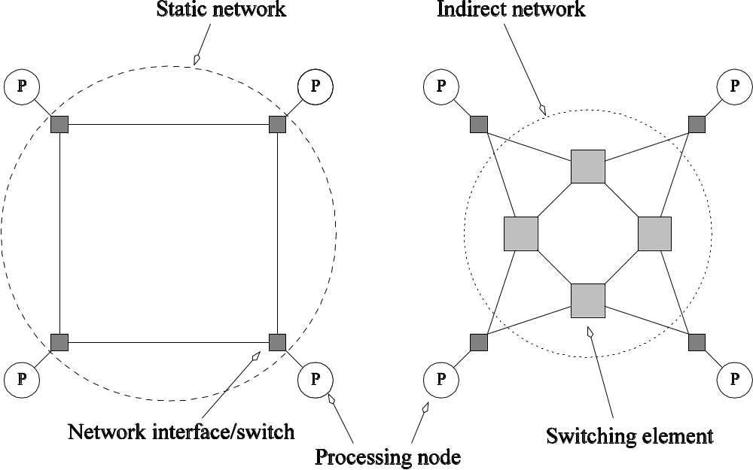
Static and Dynamic
Interconnection Networks
Classification of interconnection networks: (a) a static network; and (b) a dynamic network.

Slide 42
Interconnection Networks
Switches map a fixed number of inputs to outputs.
The total number of ports on a switch is the degree of the switch.
The cost of a switch grows as the square of the degree of the switch, the peripheral hardware linearly as the degree, and the packaging costs linearly as the number of pins.

Slide 43
Interconnection Networks:
Network Interfaces
Processors talk to the network via a network interface.
The network interface may hang off the I/O bus or the memory bus.
In a physical sense, this distinguishes a cluster from a tightly coupled multicomputer.
The relative speeds of the I/O and memory buses impact the performance of the network.

Slide 44
Network Topologies
A variety of network topologies have been proposed and implemented.
These topologies tradeoff performance for cost.
Commercial machines often implement hybrids of multiple topologies for reasons of packaging, cost, and available components.

Slide 45
Network Topologies: Buses
Some of the simplest and earliest parallel machines used buses.
All processors access a common bus for exchanging data.
The distance between any two nodes is O(1) in a bus. The bus also provides a convenient broadcast media.
However, the bandwidth of the shared bus is a major bottleneck.
Typical bus based machines are limited to dozens of nodes. Sun Enterprise servers and Intel Pentium based shared-bus multiprocessors are examples of such architectures.

Slide 46
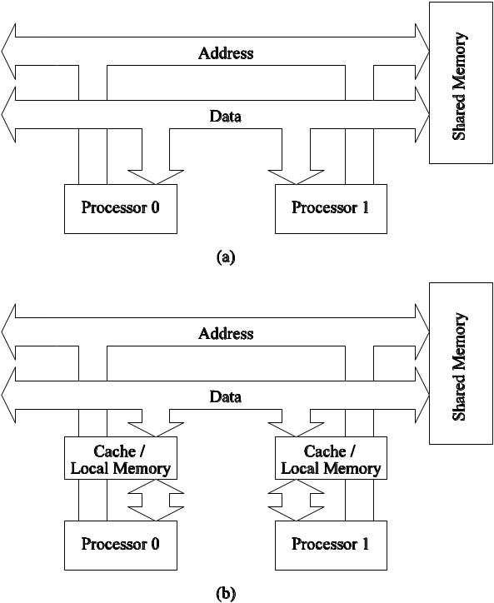
Network Topologies: Buses
Bus-based interconnects (a) with no local caches; (b) with local memory/caches.
Since much of the data accessed by processors is local to the processor, a local memory can improve the performance of bus-based machines.

Slide 47
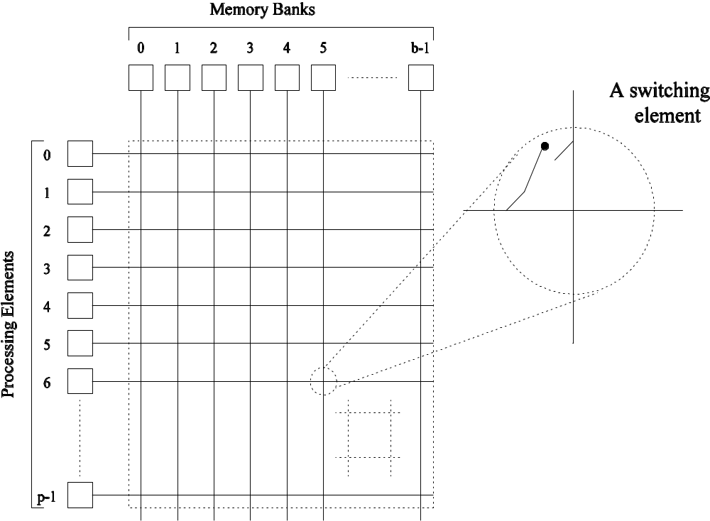
Network Topologies: Crossbars
A crossbar network uses an p×m grid of switches to connect p inputs to m outputs in a non-blocking manner.
A completely non-blocking crossbar network connecting p processors to b memory banks.

